Slide 1
AI/ML for Fusion Challenge: Multi-Machine Disruption Prediction
12/12/2023
Dian Lu (Ludian)
ASIPP, China
Dian.lu1997@gmail.com

Slide 2
I
Hypotheses Development
The disruptive signals “LOOKS” different in the temporal domain.
Train small models with small training datasets.
It’s difficult to find the common features among the 3 devices:
- System configurations are vastly different.
- Positions of the coils and X-ray sightlines not given for the test set.
- Time scale not specific for the test set.
2

Slide 3
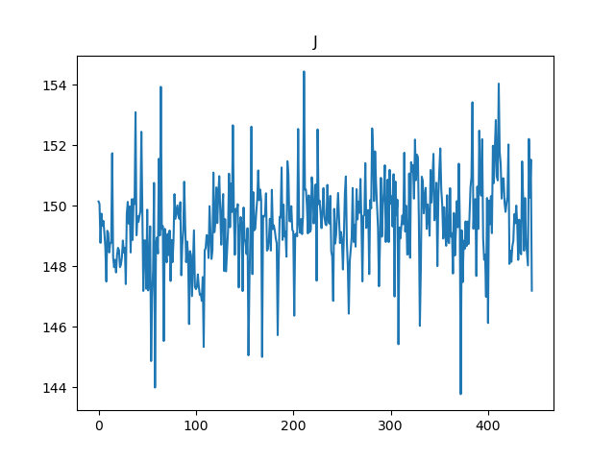
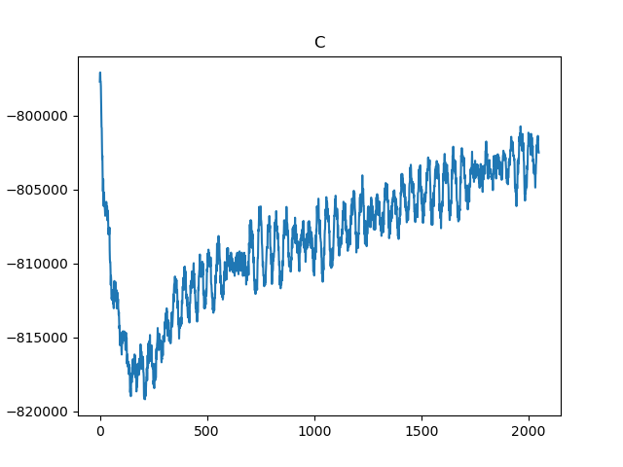
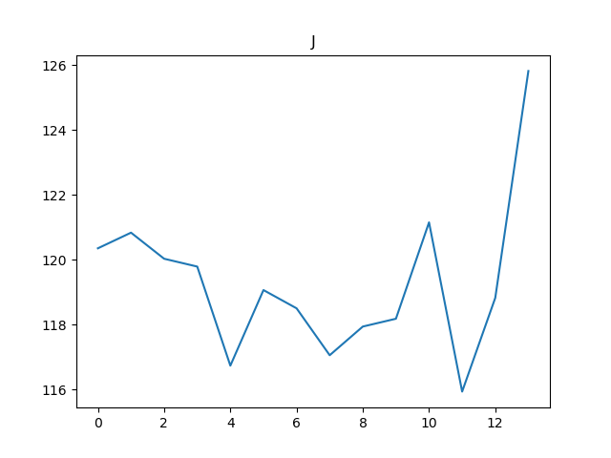
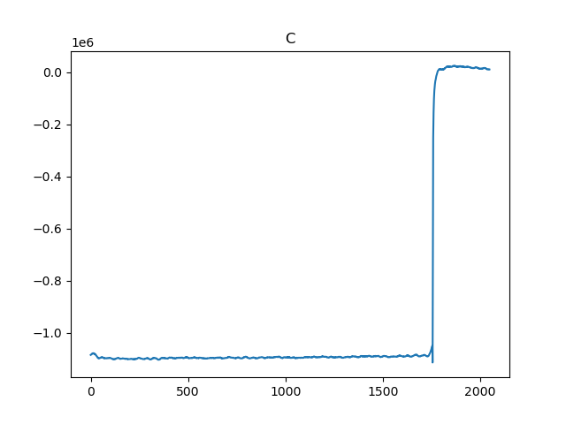
I
Hypotheses Development
Normal
<- J-TEXT
C-Mod ->
Disruptive
2

Slide 4
II
Methodology: Strategy
Process each of the signal channels with small-scale CNNs (ssCNN), and connect them with a voting network.
Signals chosen:
Plasma Current (ip)
Horizontal and Vertical Displacements (dx & dy)
Plasma Density (ne)
C3 Radiation (c3)
Loop Voltage (vl)
N = 1 Norm (n1n)
Q95 (q95)
IP Error (ipe)
3

Slide 5
III
Methodology: Model Architecture
Channel Rate 1
ssCNN 1
Signal 1
Channel Rate 2
ssCNN 2
Signal 2
Final Rate
Voting Network
Channel Rate 3
ssCNN 3
Signal 3
Channel Rate 4
ssCNN 4
Signal 4
Channel Rate 5
ssCNN 5
Signal 5
4

Slide 6
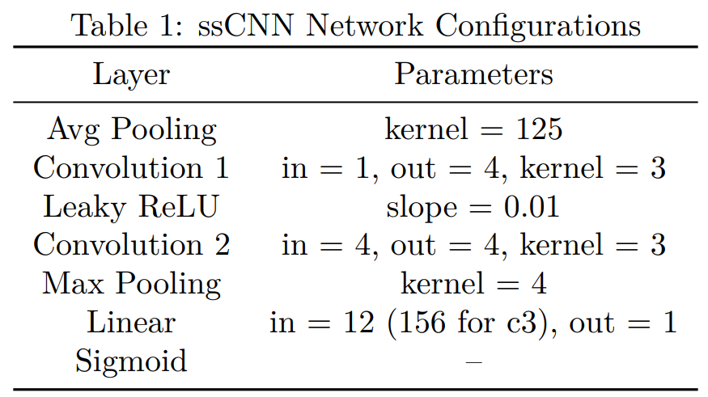
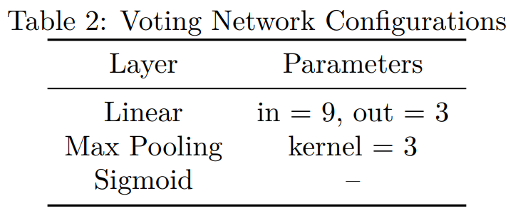
III
Methodology: Model Architecture
4

Slide 7
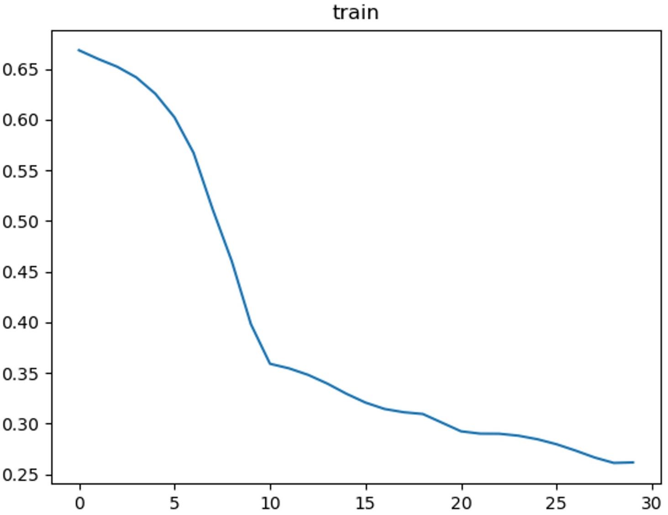

III
Methodology: Model Architecture
Adam Optimizer
BCELoss Loss Function
Multistep Learning Rate Scheduler
Interpolate to normalize the signal lengths.
Chop off ~ 60 ms at the end of the training signals.
3

Slide 8
III
Methodology: Model Architecture
Abnormally short signals (A very important criterion):
- If the signal is shorter than a certain value, it is directly classified as disruptive.
- Zero-padding the abnormally short signals.
3

Slide 9
IV
Results: Part 1
With only a single channel, the F1 score is about 0.73-0.79 (depending on which channel I choose).
With the channels connected by the voting network, the F1 score is about 0.88-0.91 (depending on how I set the threshold).
With the abnormally short signal criterion applied, the F1 score can reach 0.917.
TP rate = 0.934, FP rate = 0.051
5

Slide 10
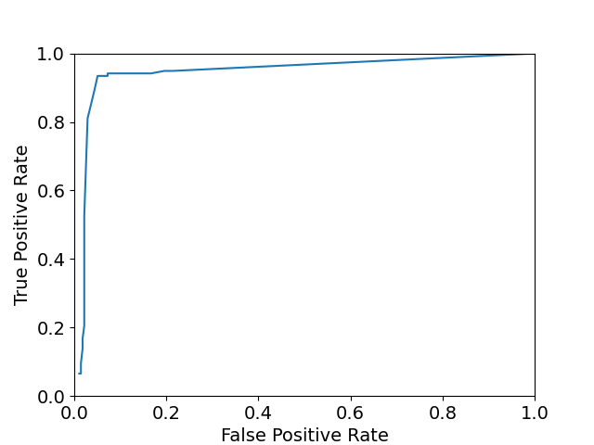
IV
Results: Part 2
ROC curve:
6

